Slide 1

Trading Eye Project
BC-CS-26-136
STUDENT: TAIR NOY
SUPERVISOR: JEREMY MILLER

Slide 2
INTRODUCTION
The stock market is simply where people buy and sell ownership pieces, or stocks, of companies. When you buy a stock, you become a tiny owner, hoping the company grows so your share becomes more valuable. However, investing is always about balancing two things: risk - the chance of losing money and reward - how much you can potentially earn.
This is exactly why we created the Trading Eye Project. We use Computer Science and data analysis to investigate the market, helping us find the best opportunities and manage the risk. Our goal is to give investors a clear, smart, and strong plan for their money.

Slide 3

THE PROBLEM
The Problem: Traditional investing is overwhelmed by data, which often leads to errors.
Too Much Data: Today's market moves too fast and creates too much data for any person to check completely.
Decisions Are Guesswork: When people can't check all the data, their decisions are often based on incomplete facts, leading to mistakes and bad investments.
Need for a System: We are missing a reliable, automated tool that uses computer analysis to consistently find the best and safest trading moves.

Slide 4
RELATED WORK
Existing algorithmic trading solutions primarily focus on two areas: signal detection (finding short-term price movements) or portfolio optimization (managing risk across many assets). While effective, this research often overlooks the strategic nature of the market. Current systems typically employ reactive models that analyze data after it happens or use complex, "black box" methods (like some Neural Networks) that lack transparency. Crucially, they do not account for how other traders will react to their strategy. The Trading Eye Project addresses this gap by introducing advanced strategic analysis. This allows us to design proactive, transparent strategies that are inherently more secure and stable than the reactive models used by existing solutions.

Slide 5
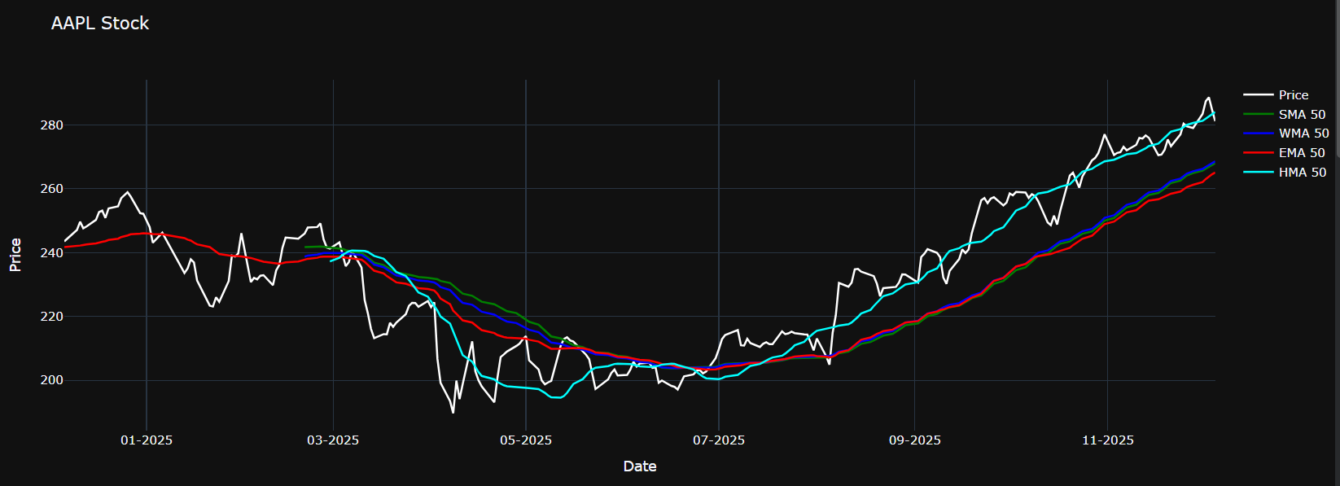
Methodology: Core Calculation and Analysis
Trend Filtering (Moving Averages): We combine multiple price averages (SMA,EMA, WMA, and HULL) to accurately filter market noise and identify the clear direction of the main trend.

Slide 6
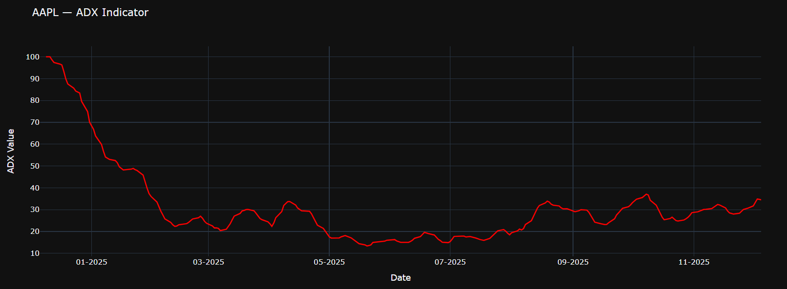
Methodology: Core Calculation and Analysis
Trend Strength (ADX): The ADX indicator is calculated to precisely measure the strength and momentum of the current trend, ensuring we only enter stable opportunities.
Price Boundaries (HH/LL): We define the market's operating range by calculating the HH (Highest High) and LL (Lowest Low), which set the crucial risk and profit boundaries for every strategy.

Slide 7
What's Next: Our Future Plan
The Trading Eye Project proves that a smart system can create better and safer trading plans. Now, we have two main goals for the future: to learn more and to build a great app.
Learning More (Research): We will keep studying how our indicators (like ADX and HULL) work in different market situations. This ongoing research will help us constantly make our strategies stronger and more up-to-date.
Building the App (Development): Our next step is turning this powerful system into a simple, easy-to-use application. We want to design a clear screen with great graphs so any user can quickly see and use our smart trading plans to manage their money better.
In short, we are working to take complex science and put it into a simple tool that makes smart trading easy for everyone.
Notes:
The Innovation: The algorithm uses advanced strategic analysis to find the right balance between risk and profit, helping us determine the most secure trading strategies.

Slide 8
Thank you

